Slide 1
Simple Shooter
Part 1
by TommyX

Slide 2
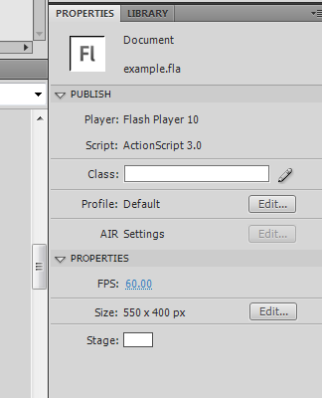
Setting up the stage
Lets setup our basic settings such as frame rate or window size.
Click on empty spots on the stage and edit these settings in the properties menu.

Slide 3
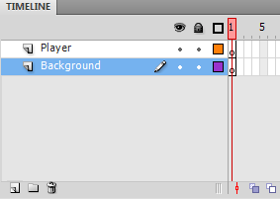
Setting up layers
Layers in Flash can be used to organize objects on the stage. Objects in top layers will appear in front of objects in bottom layers.
We will need two layers, one for the player, and one for the background.
Click here to create a new layer.
Double click to change layer name. Drag to arrange them.

Slide 4
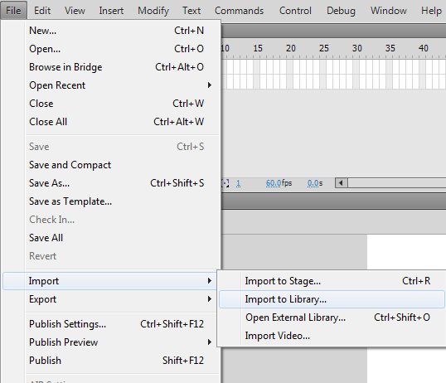
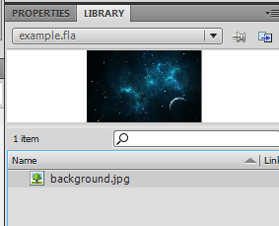
Importing images
Once the image is imported, its embedded in the flash file and will not change if the source image is changed.
Import one or more assets to the library by clicking here.

Slide 5
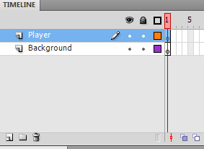
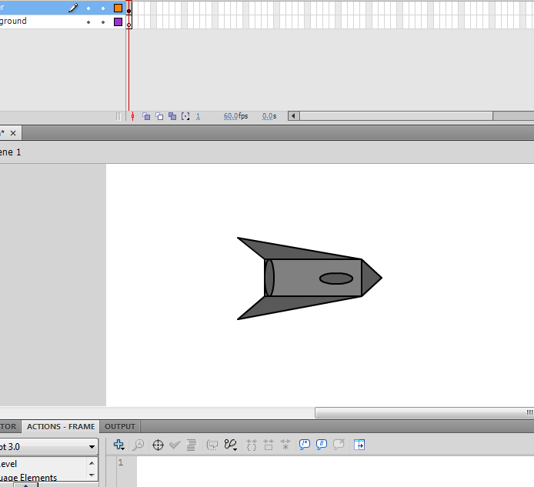
Creating the player
Click on the frame to select the frame and its layer.
Draw the player using various tools on the right.

Slide 6
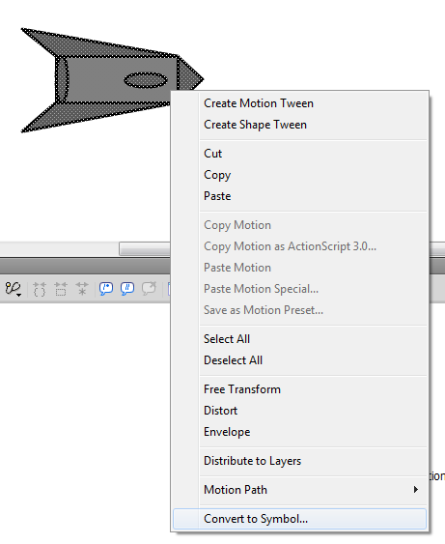
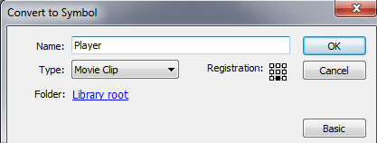
Creating the player
Select all the shape, right click on it and select Convert to Symbol.
Give it a library name, make sure to select type Movie Clip. Then click OK.

Slide 7
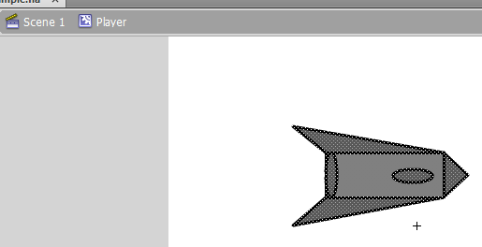
Creating the player
Double click the object to edit it. You can position the object so that its origin is more appropriate.
When you finished editing, hit here to return to stage.

Slide 8
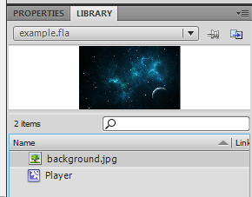
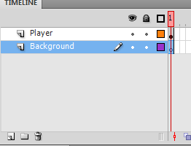
Creating the background
We will use this image we imported as the background. Although placing the image directly on the stage works, in order to control it with code, we will have to make it an object as well.
Click on the frame of the Background layer.

Slide 9
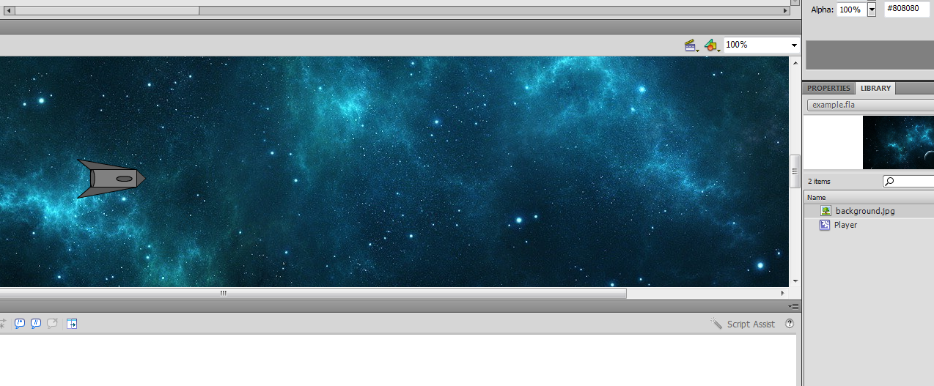
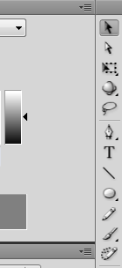
Creating the background
Drag the image onto the stage.
If the image is too large, zoom out using this menu, then scale the image using this tool.

Slide 10
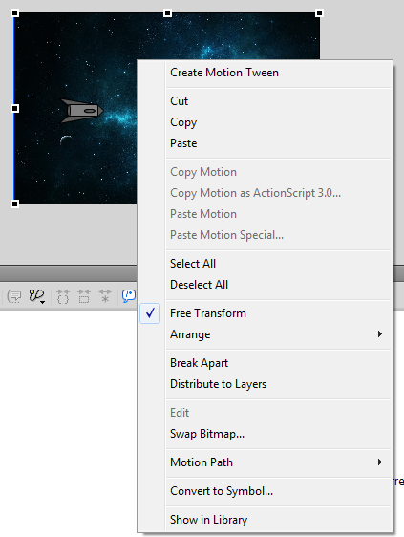
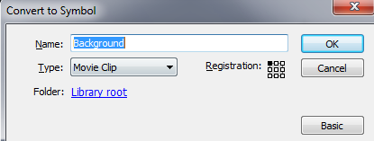
Creating the background
After resizing, select the image, right click and hit Convert to Symbol.
Give it a library name, make sure to select type Movie Clip. Then click OK.

Slide 11
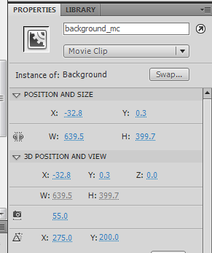
Initializing the background
Select the background object, in the properties menu, give it an instance name. This is the name we will use to control it with code, and no other object on the stage should have the same name.
(“_mc” is a short suffix for MovieClip)

Slide 12
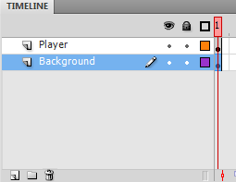
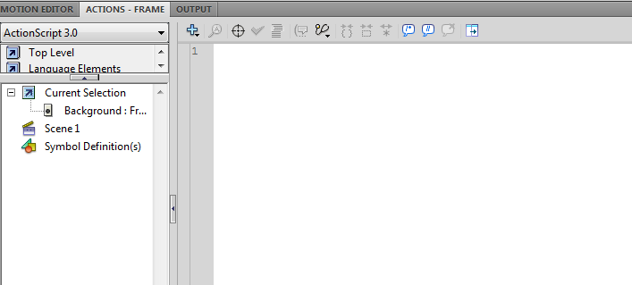
Initializing the background
Click on the frame of the Background layer.
Its important to know that layers and frames can also be used to organize code. Here, in a frame of the Background layer, we will put code that’s related to the background.
background_mc.x = 0
background_mc.y = 0
Initialize the position of our background_mc

Slide 13
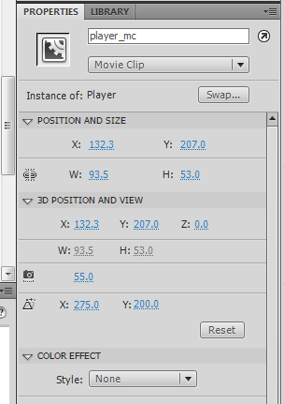
Initializing the player
Select the player object, in the properties menu, give it an instance name. This is the name we will use to control it with code.

Slide 14
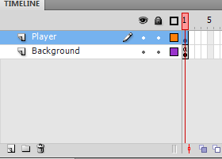
Initializing the player
Click on the frame of the Player layer.
Lets initialize our player’s position, rotation and size.
stage.stageHeight gives you the height of the stage.
player_mc.x = 100
player_mc.y = stage.stageHeight / 2
player_mc.scaleX = 1
player_mc.scaleY = 1
player_mc.rotation = 0

Slide 15
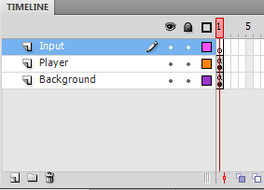
Setting up Inputs
To setup our inputs, we need another layer just to organize the code.
Click on the frame of the Input layer, and edit the script. We will setup the input using the method in the previous lesson, and the example code will be in the example file.

Slide 16
Controlling the player
Click on the frame of the Player layer. Now we can add the simple player movement using the code below.
player_mc.x = 100
player_mc.y = stage.stageHeight / 2
player_mc.scaleX = 1
player_mc.scaleY = 1
player_mc.rotation = 0
var playerSpeed:Number = 5
function enterFrameHandler(event){
if (keyUpDown){
player_mc.y -= playerSpeed
}
if (keyDownDown){
player_mc.y += playerSpeed
}
if (keyLeftDown){
player_mc.x -= playerSpeed
}
if (keyRightDown){
player_mc.x += playerSpeed
}
}
addEventListener(Event.ENTER_FRAME, enterFrameHandler)

Slide 17
Information on Logical Statements
http://www.republicofcode.com/tutorials/flash/as3conditionals/
http://www.adobe.com/devnet/actionscript/learning/as3-fundamentals/conditionals.html

